Slide 1
Predicting Reasons for Crosswalk in American’s Health Insurance Plans
Name: Vivan Raaj
Date: 3rd April 2016

Slide 2
Background
American Health Insurance Marketplace
For People who don’t have health coverage
What you for insurance depends on your income
If you don’t have health insurance, you have to pay a fee/penalty

Slide 3
Problem
Insurance Plan 2014
Insurance Plan 2015
Crosswalk ?
No
Yes

Slide 4
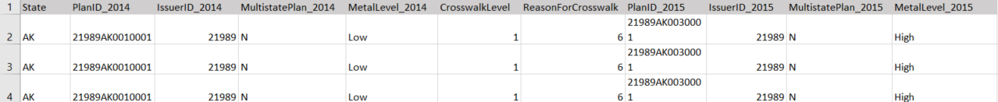
Data Wrangling
Data is obtained from Health Insurance Marketplace dataset at Kaggle.
After cleaning the data, we get the below ‘clean’ columns :

Slide 5
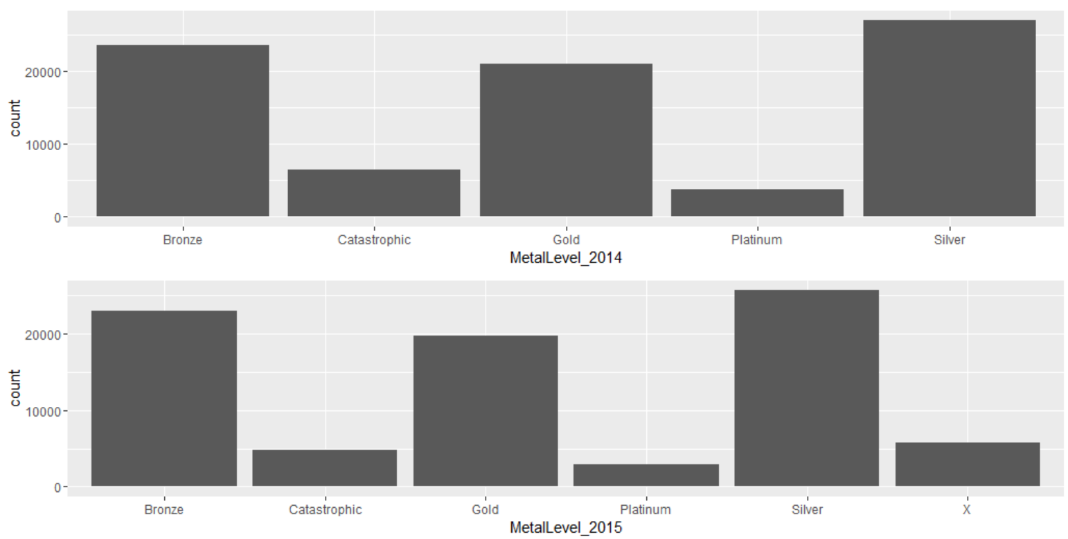
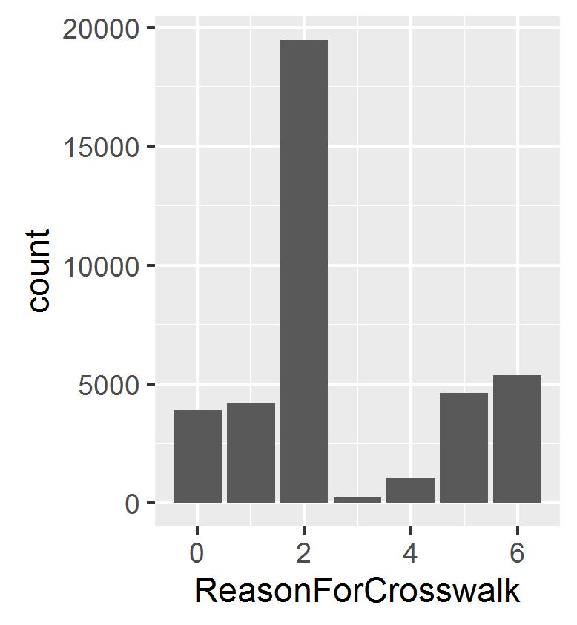
Data Exploration
We generate the below bar plots:

Slide 6

Prediction Algorithms
Multinomial Logistic Regression
Prediction Model 1:
3 independent variables ; MultistatePlan_2014, MetalLevel_2014 & CrosswalkLevel
Prediction Model 2:
2 independent variables ; MetalLevel_2014 & CrosswalkLevel

Slide 7
Recommendations
To include multistate plan as a standard clause in every insurance plan as more Americans will be more inclined to purchase them. The only stumbling block will be the different state policies in regards to insurance plans.
Individuals may be too confused/overwhelmed when choosing coverage for insurance plans hence the unequal pattern seen in the metal level bar plot. My recommendations to solve this problem is to reduce no. of options for coverage plan which may entail more simplified package of insurance plan. Thus those that pay for low insurance premium may not necessarily have to pay for higher health cost but instead slightly lower health cost.

